Slide 1

"Review of Mini Project”
for E-3 2016 CSE
Submitted as part of Mini Project.
M. Laxminarayana
S160307
G. Rajesh
S160215
Y. Sai Krishna
S160821
K.E Padma Kumar
S160499
Under the Supervision of:
T. Anil Kumar
Department of Computer Science and Engineering
Rajiv Gandhi University of Knowledge Technologies
Srikakulam – 532402
Email: anilkumar10491@gmail.com
‹#›

Slide 2
FACIAL EXPRESSION RECOGNITION

Slide 3
Introduction
“2018 is the year when machines learn to grasp human emotions”
-- Andrew Moore.
Image processing is the field of signal processing where both the input and output signals are images. One of the most important applications of Image processing is Facial expression recognition. Our emotion is revealed by the expressions in our face. Facial Expressions plays an important role in interpersonal communication.
Facial expression is a non verbal scientific gesture which gets expressed in our face as per our emotions. Automatic recognition of facial expression plays an important role in artificial intelligence and robotics and thus it is a need of the generation. Some application related to this includes Personal identification and Access control, Videophone and Teleconferencing, Human-Computer Interaction, Automated Surveillance and so on.
Several Projects have already been done in this fields and our goal will not only be to develop an Automatic Facial Expression Recognition System but also improving the accuracy of this system compared to the other available systems.

Slide 4
Motivation of Project Work
Humans are well-trained in reading the emotions of others, in fact, at Just 14 months old, babies can already tell the difference between happy and sad. In the Current Technological World everyone are using Electronic devices like mobiles, computers etc. more than 8 hours a day.
Can we make our Computers to understand our emotions ?
To answer the question, We designed a deep learning neural network that gives machines the ability to make inferences about our emotional states. In other words,
“we give them eyes to see what we can see’’
Making a computer that understand Human emotions will bring a drastic change. It can save life’s of people by identifying who are being depressed emotionally and prevent them from committing suicide .

Slide 5
Scope of Project
By deploying the Trained model into Digital Devices Like Mobiles, Digital Cameras, Video Recorders. We easily identify the expressions of people in group and intimate the people with sad or Angry faces. This will definitely reduce the burden of taking re-shots and helps it picking up the best images.
Further By Incorporating this model in Videos Streaming Platforms, We can provide more apt suggestion to user based on their Emotional State which is determined using Webcam.

Slide 6
Analysis of Existing Models
There are various pre existing models which are trained using various facial datasets and methodologies. Each of them are having different accuracy in prediction.
Various facial datasets available online are:
Facial Emotion Recognition (FER)
Japanese Female Facial Expression (JAFFE)
Carnegie Mellon University (CMU) MultiPIE
Lifespan
Man Machine Interface (MMI)
FEED
Cohn Kanade (CN)

Slide 7
Accuracy of Models trained using various datasets:
Training | Testing | Accuracy
FER2013 | CK+ | 75.05
FER2013 | CK+ | 73.38
JAFFE | CK+ | 54.05
MMI | CK+ | 66.20
FEED | CK+ | 56.60
FER2013 | JAFFE | 50.70
FER2013 | JAFFE | 45.07
CK+ | JAFFE | 55.87
BU-3DFE | JAFFE | 41.96
CK | JAFFE | 45.71
CK | JAFFE | 41.30
FEED | JAFFE | 46.48
FEED | JAFFE | 60.09

Slide 8
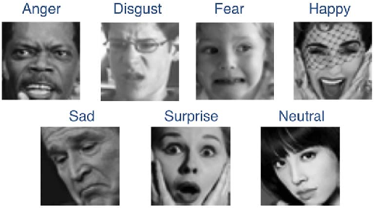
Objective:
This project is to develop Automatic Facial Expression Recognition System which can take human facial images containing some expression as input and recognize and classify it into seven different expression classes such as:

Slide 9
Implementation of Model :
1
2
3
4
Pre-processing
Face detection
Feature extraction and Model Development
Expression classification

Slide 10
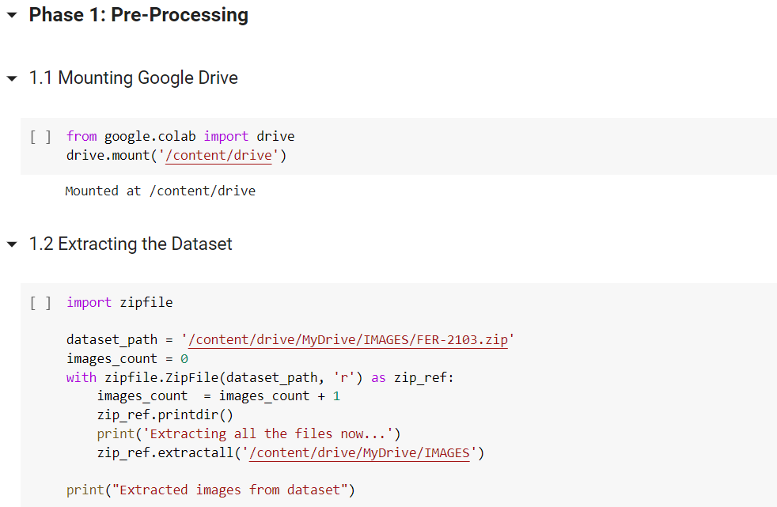

Slide 11
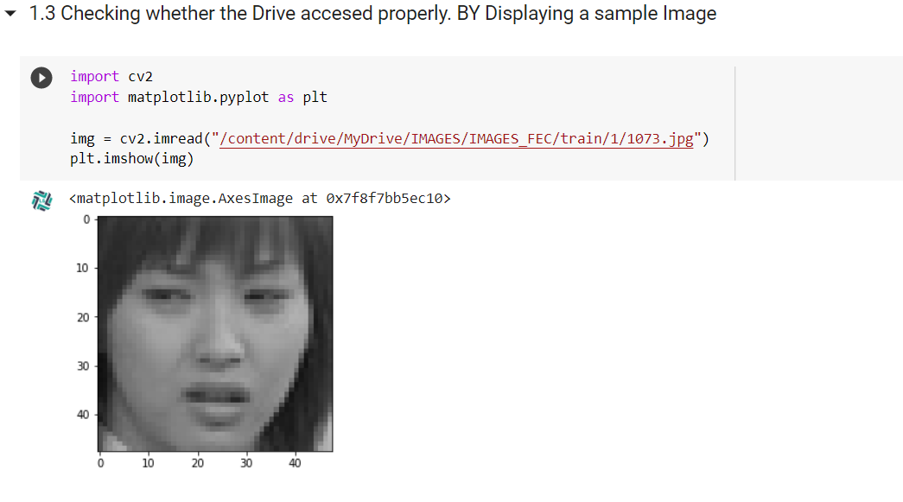

Slide 12
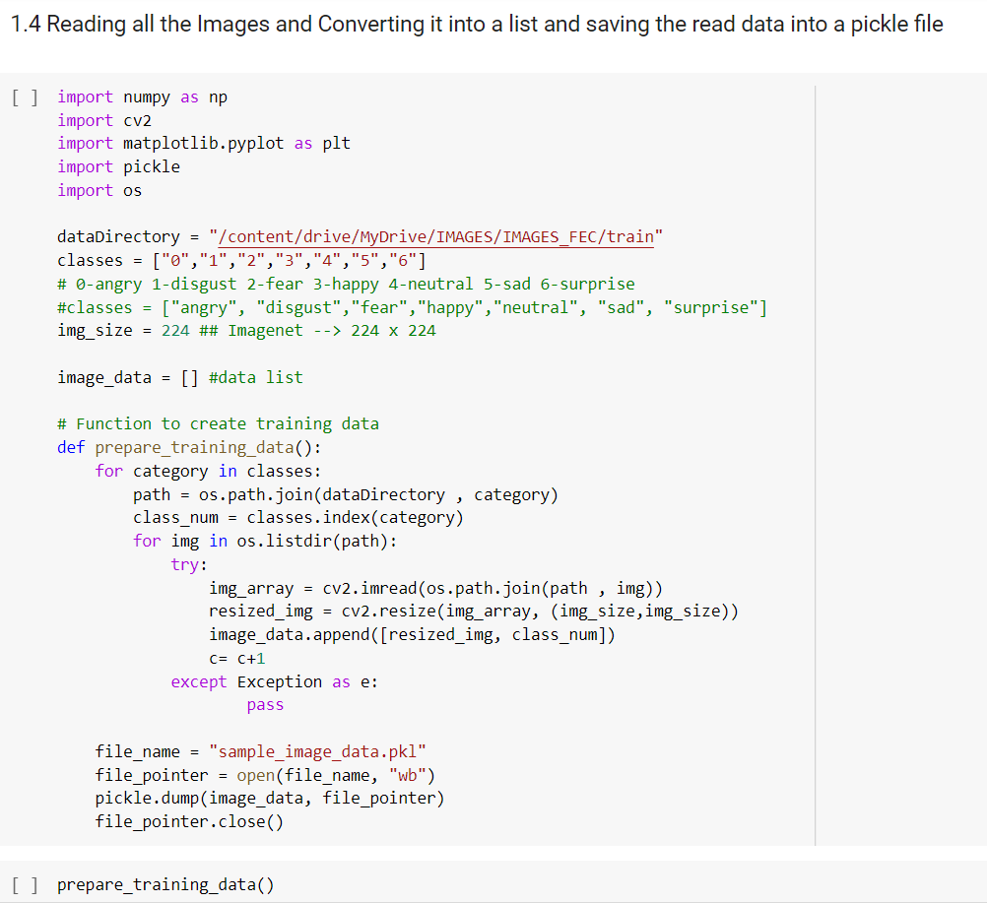

Slide 13
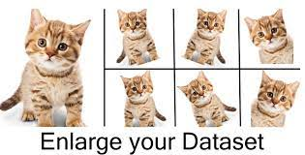
DATA SET:
https://www.kaggle.com/jonathanoheix/face-expression-recognition-dataset
Later We have to perform
Cleaning of the Collected Data like removing the corrupted files
Normalization and Augmentation of the Images in the data set
Loading the training and testing data into train and test variables.
Note:
For this model creation, We are using a dataset from Kaggle, because it is a open source.
and this is trusted data set provider Hence Cleaning of Dataset and Normalization and Augmentation are not much required

Slide 14
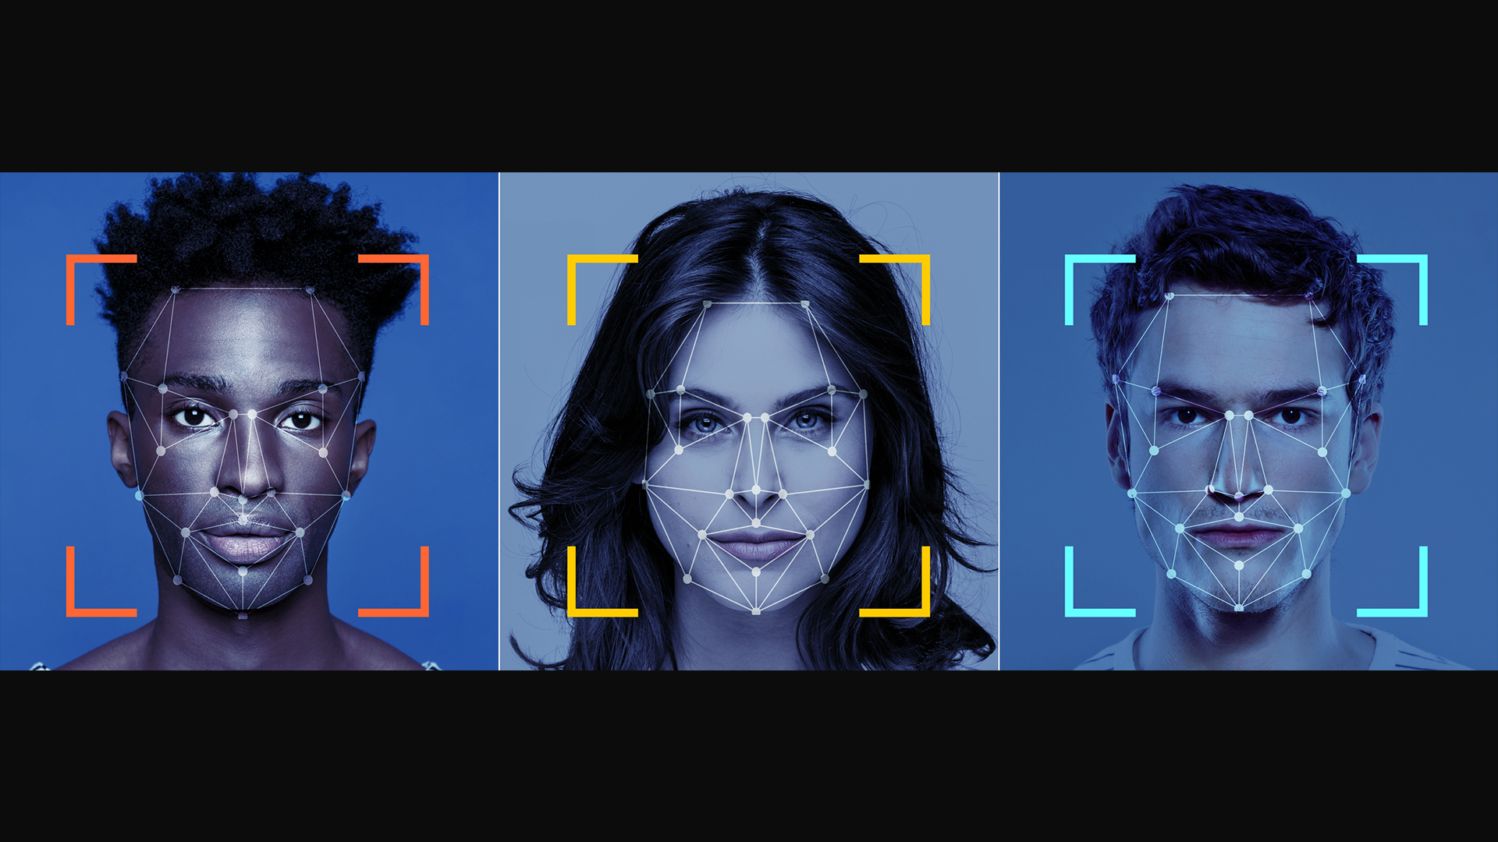
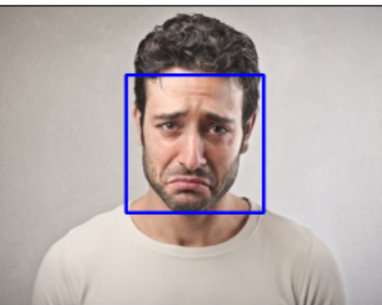
Phase 2: Face Detection
Face detection includes locating the faces in the image using some set of landmark points called as "face localization" or "face detection".

Slide 15
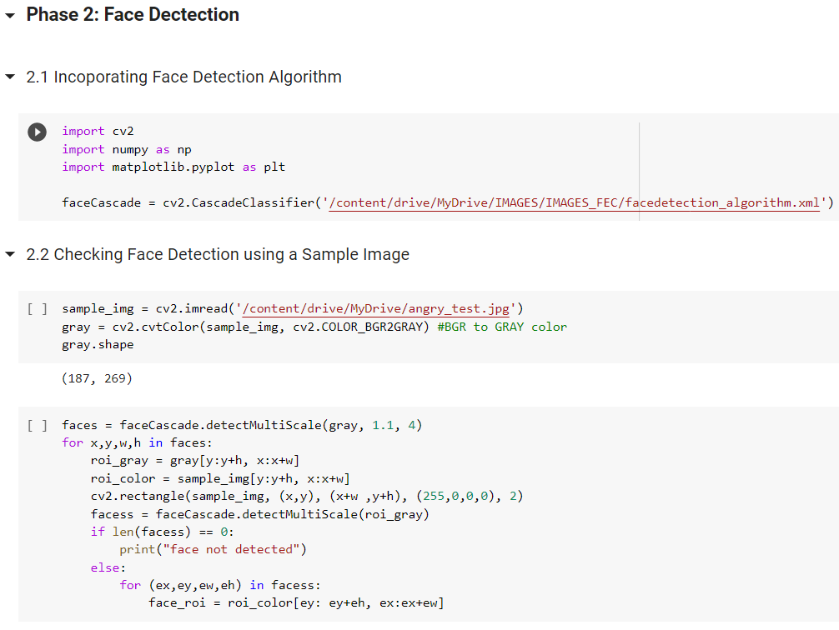

Slide 16
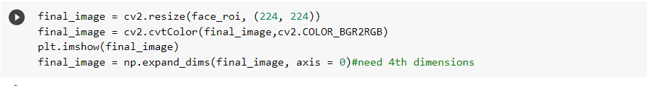
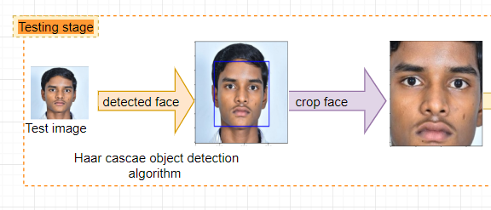

Slide 17
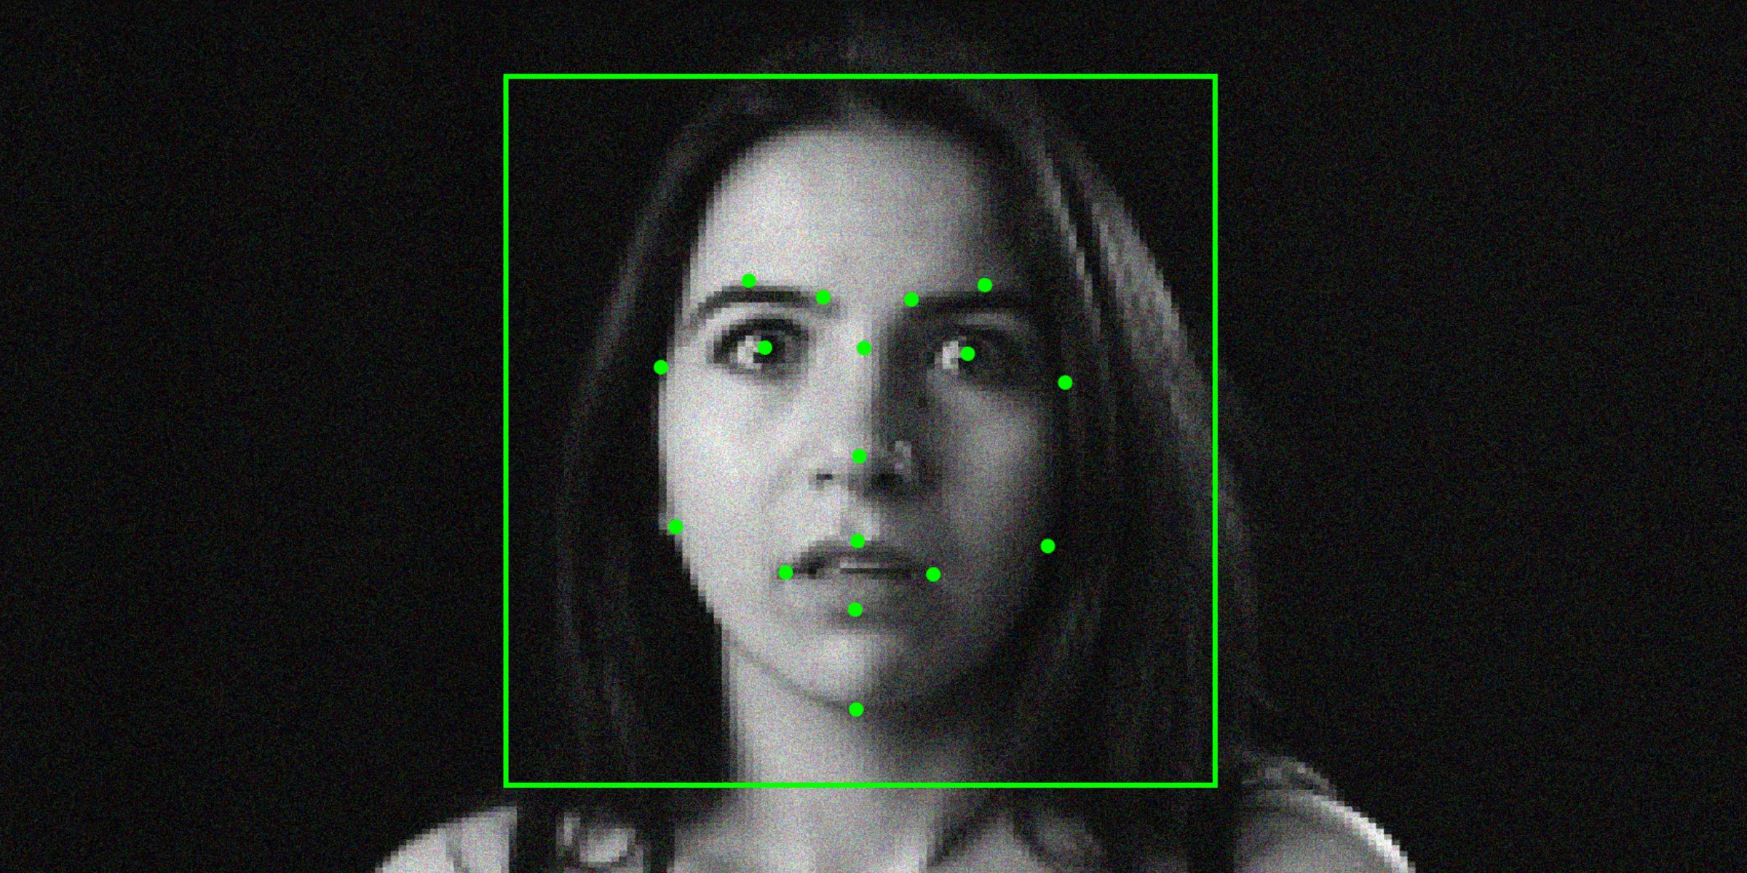
Phase 3: Features Extraction and Model development
Feature extraction is the process of locating specific regions, points, land marks, and curves in a given image.
Examples of features that can be extracted:
Lips
Eyes
Eye brows
Nose tip

Slide 18
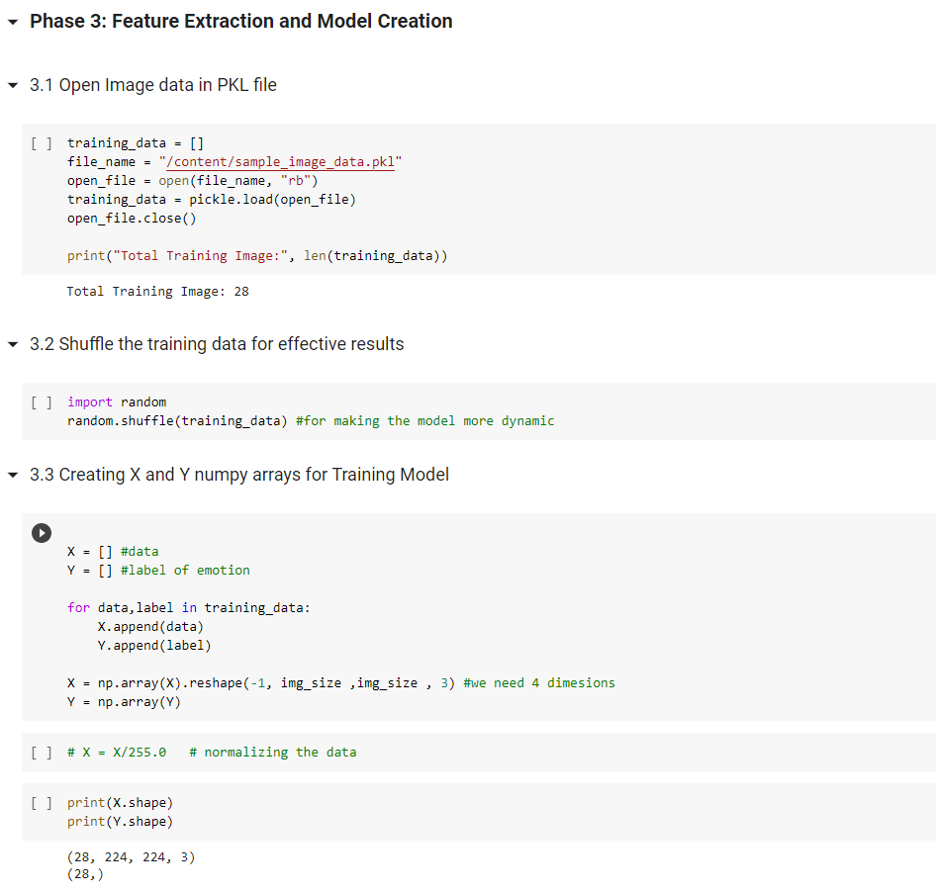

Slide 19
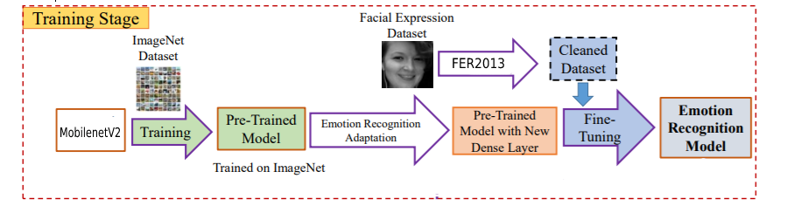

Slide 20
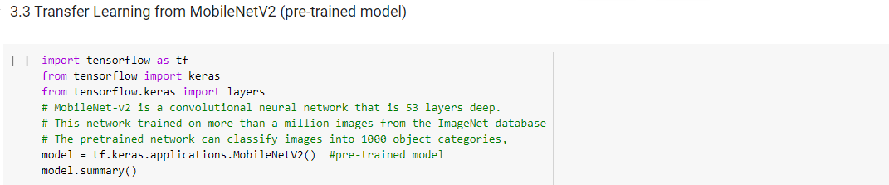
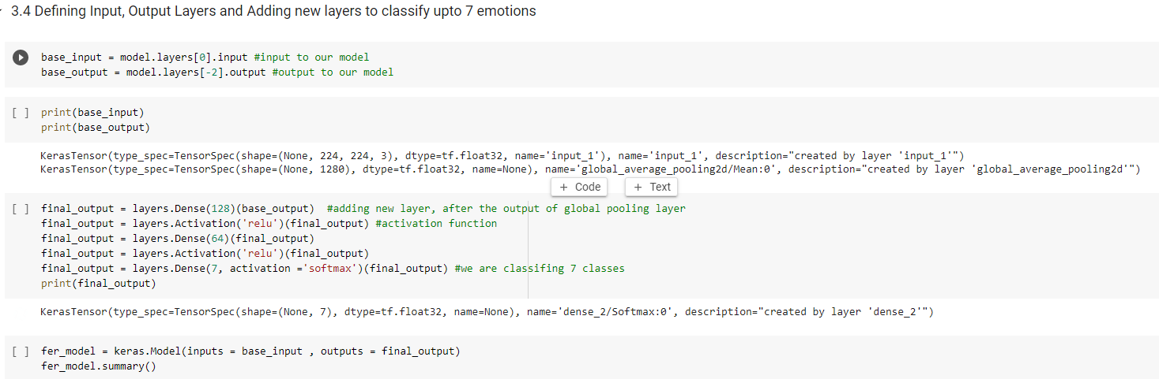

Slide 21
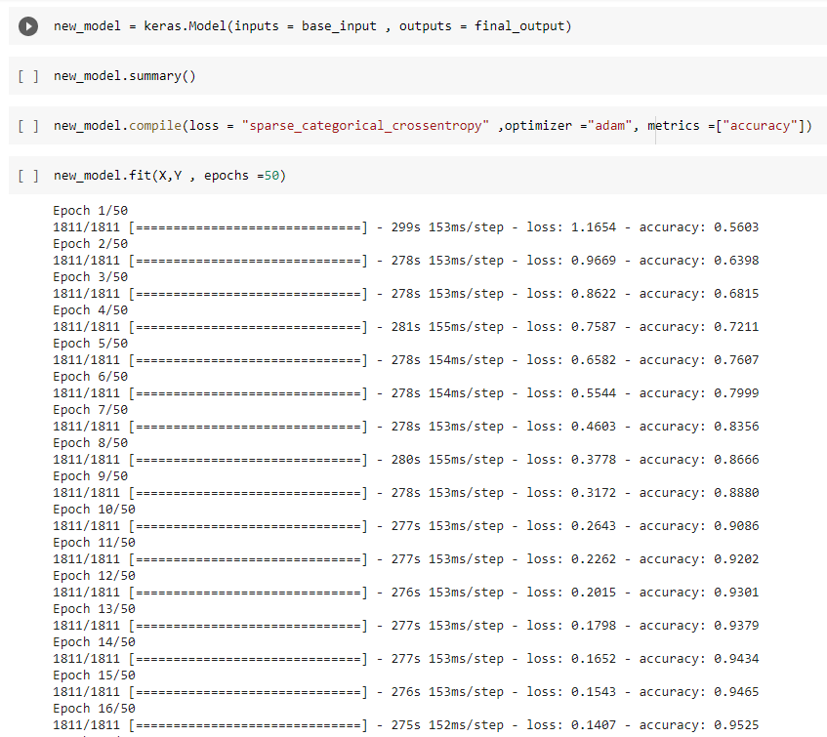

Slide 22
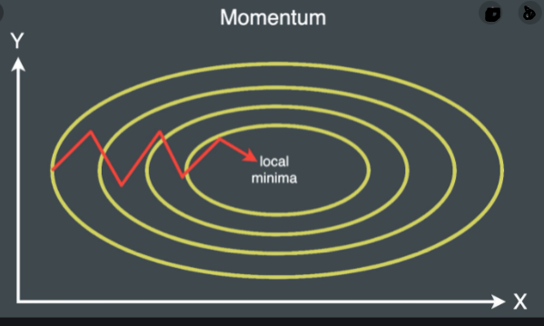
Sparse_categorical _crossentropy loss
When doing multi-class classification, categorical cross entropy loss is used a lot. It compares the predicted label and true label and calculates the loss. We use sparse categorical cross entropy when your classes are mutually exclusive (e.g., when each sample belongs exactly to one class).
Adam Optimizer
Picking the right optimizer with the right parameters, can help you squeeze the last bit of accuracy out of your neural network model
Adam combines the best properties of the AdaGrad and RMSProp algorithms to provide an optimization algorithm that can handle sparse gradients on noisy problems i.e gets the speed from momentum and the ability to adapt gradients in different directions from RMSProp.The combination of the two makes it powerful.

Slide 23
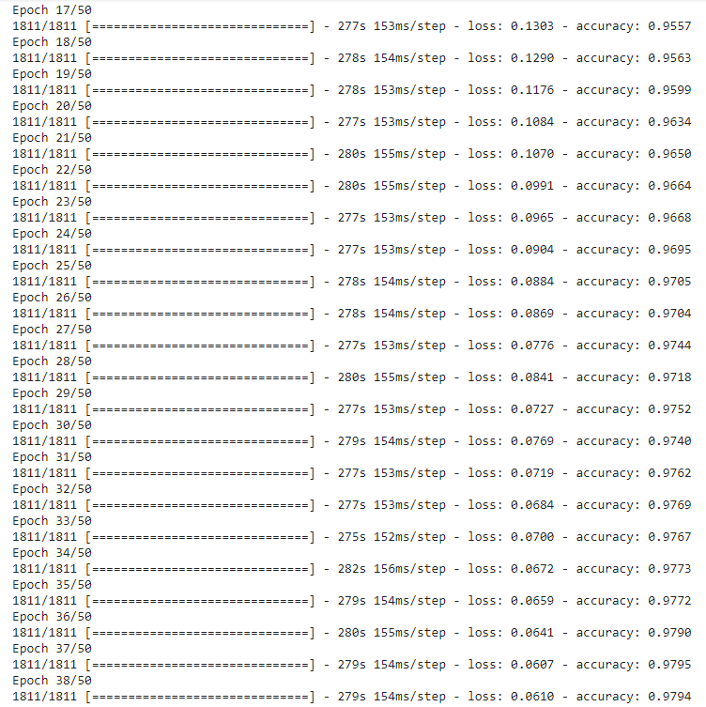

Slide 24
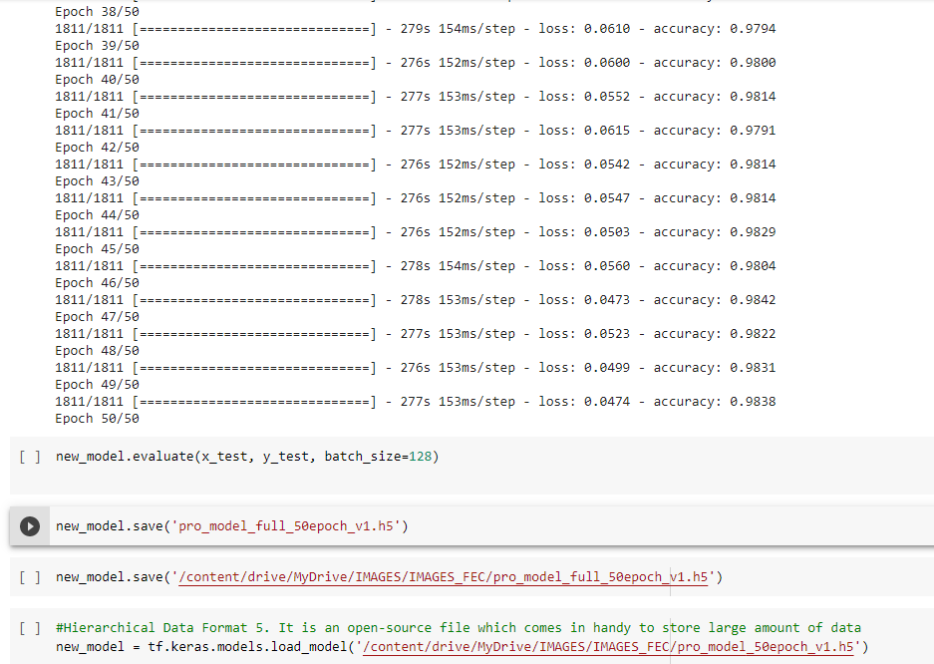

Slide 25
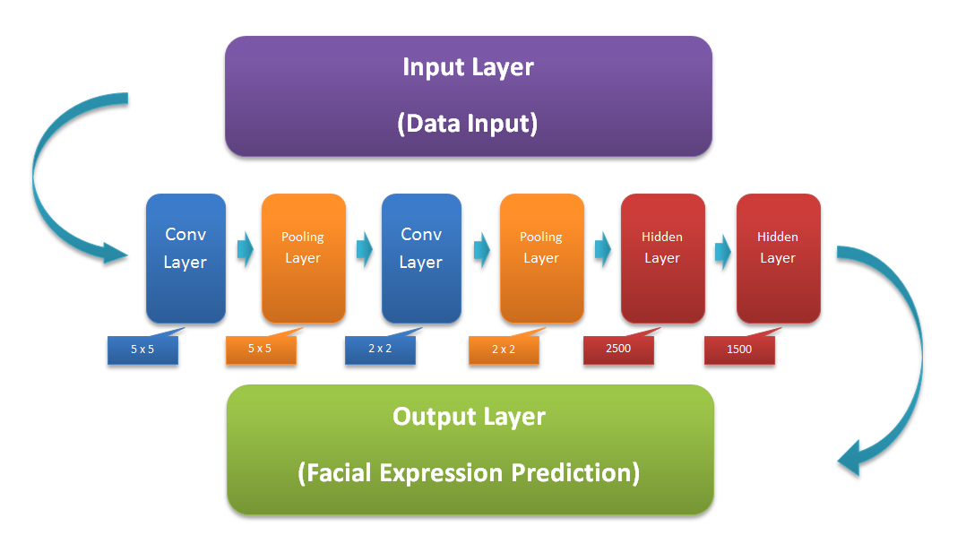
Phase 4: Expression Classification
Expression classification is the main part where our trained model comes into picture.
Our model attempts to classify the expression in the give input image based on the features extracted from that image.

Slide 26
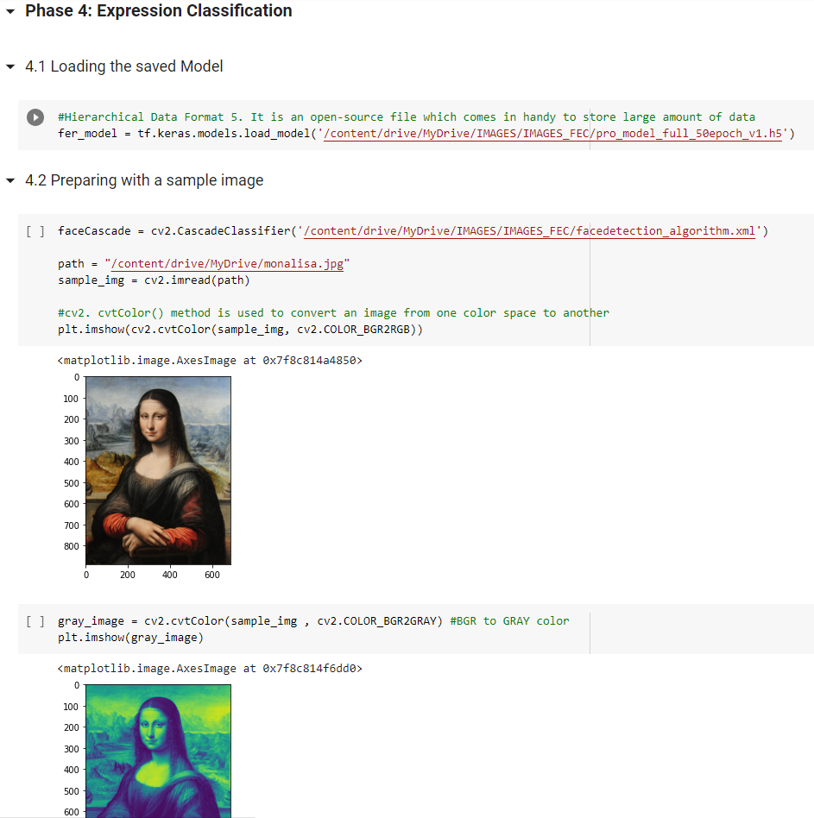

Slide 27
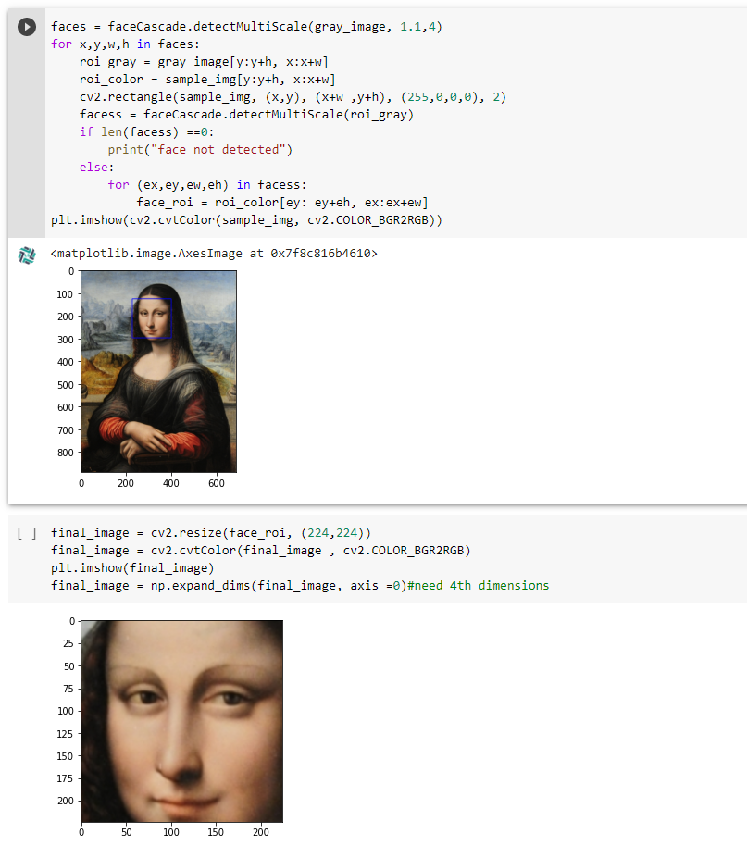

Slide 28
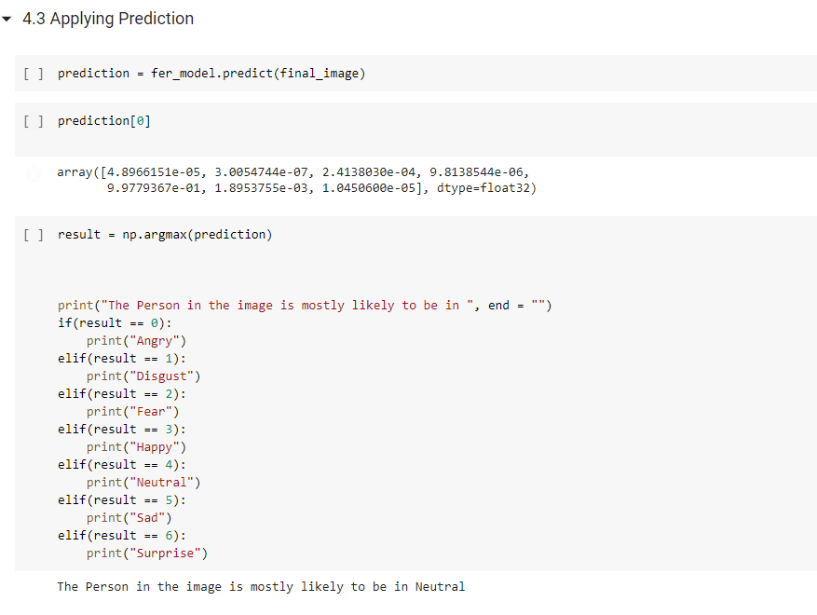

Slide 29
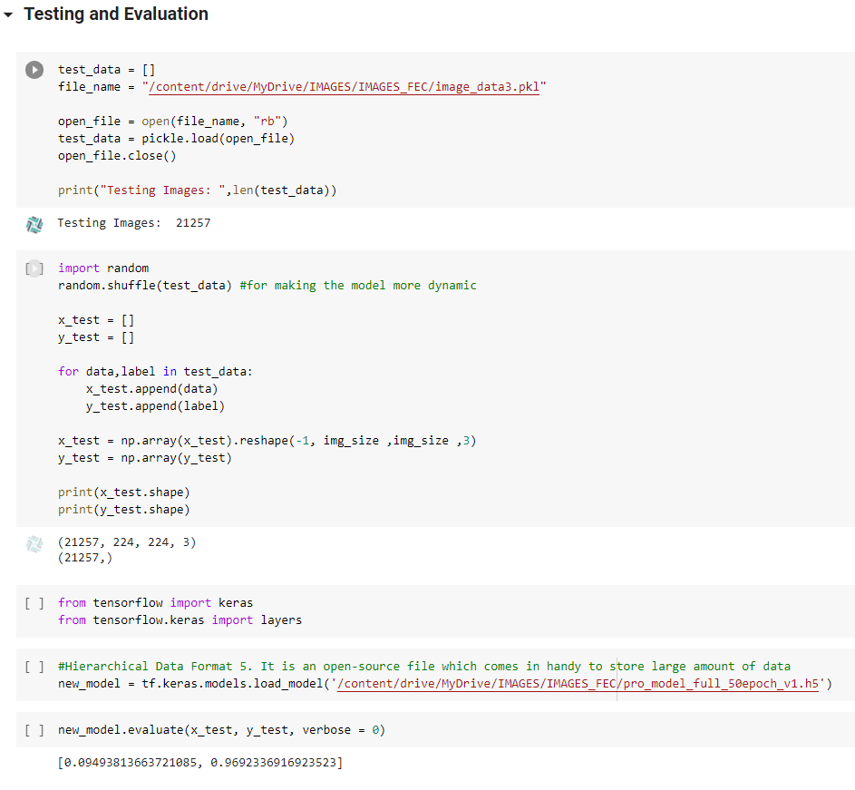
Testing and Evaluation :

Slide 30

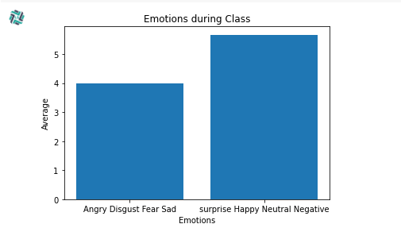
Applications:
Remote Class Students Monitoring
Sample Video: Results:

Slide 31
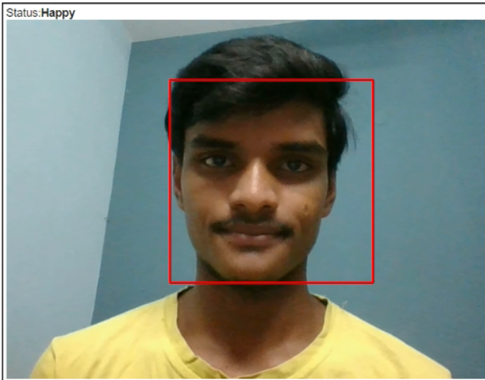
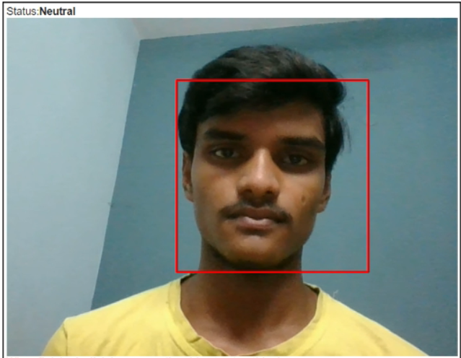
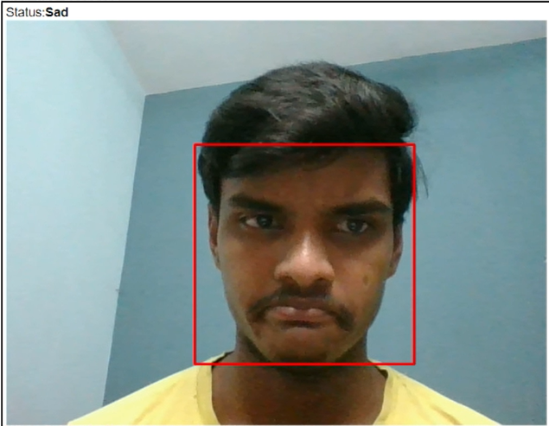
2. Emotion detection in Web Cam
‹#›
Happy Neutral Sad

Slide 32
Conclusion
All the models that are pre existing are developed using various datasets which are outdated which consist of less number of samples for training and testing.
In this Project we developed a model with accuracy of 96% using Deep Learning, Convolutional Neural Networks and Transfer Learning techniques that can predict of seven human emotions more accurately using Python with Facial Dataset provided by Kaggle.

Slide 33
Thank You

